Slide 1
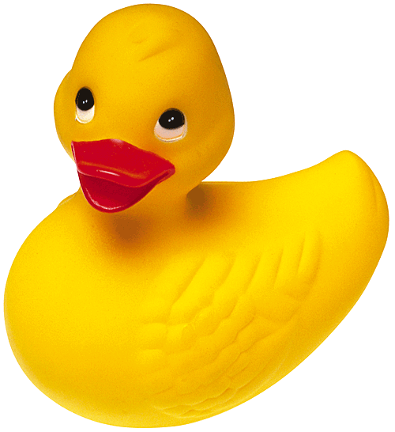
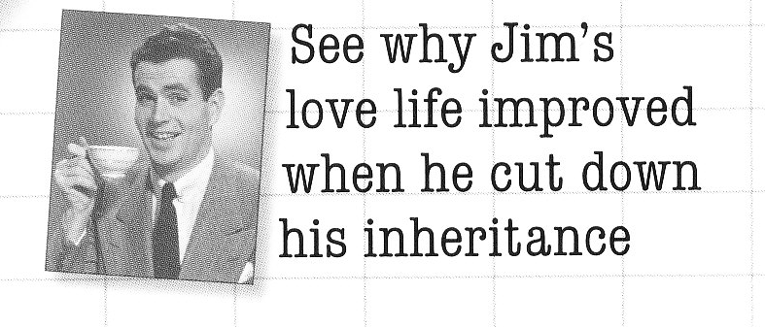
Sim-U-Duck
Welcome to Design Patterns

Slide 2
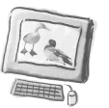
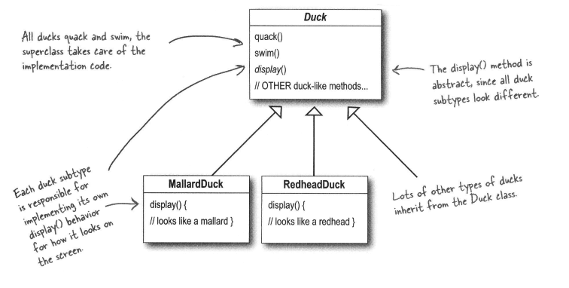
Simple Sim-U-Duck design
By Joe the programmer

Slide 3
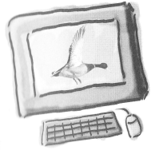
A new requirement
Ducks must be able to fly!

Slide 4
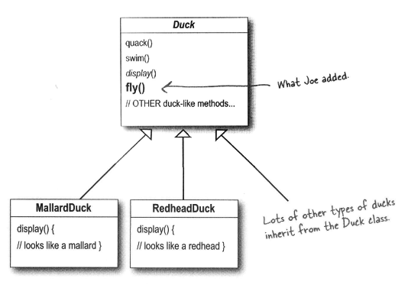
A new requirement
Ducks must be able to fly!

Slide 5
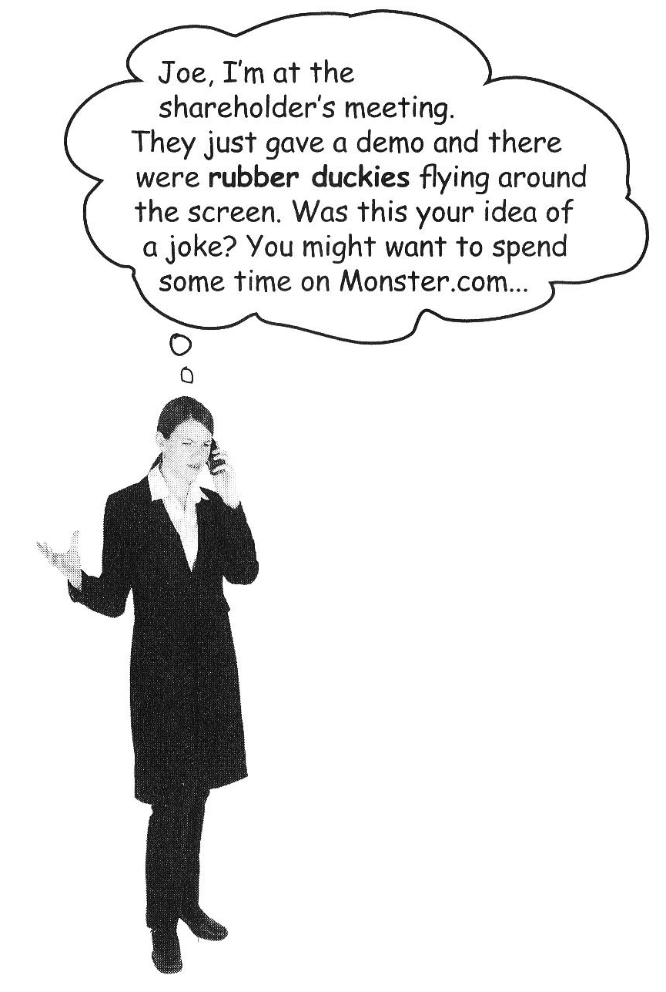
Something went wrong...
What happened?
A localized update to the code caused a non-local side effect (flying rubber ducks)!

Slide 6
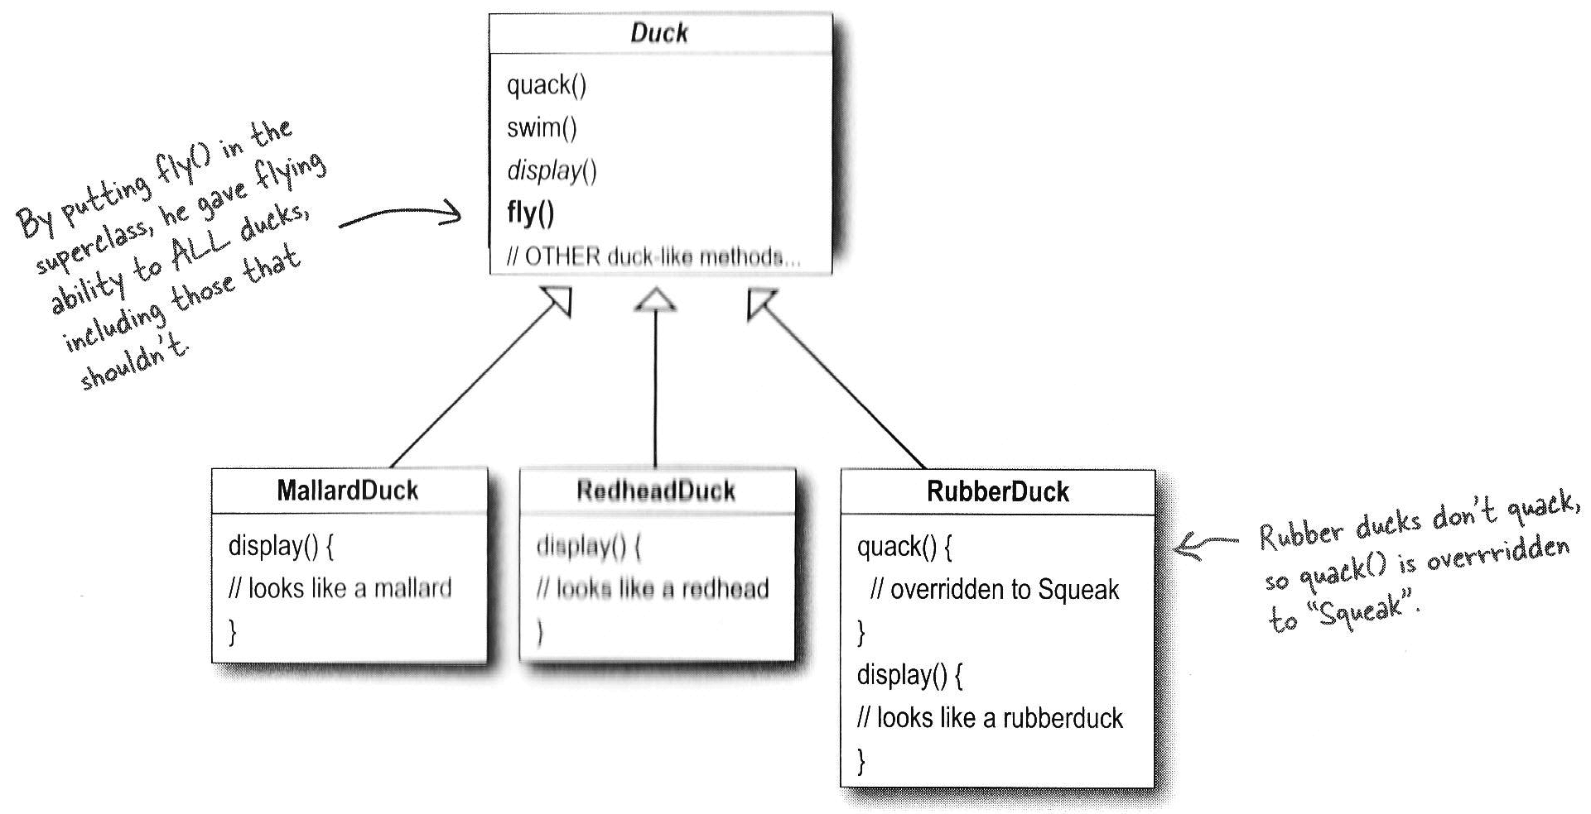
Something went wrong...

Slide 7
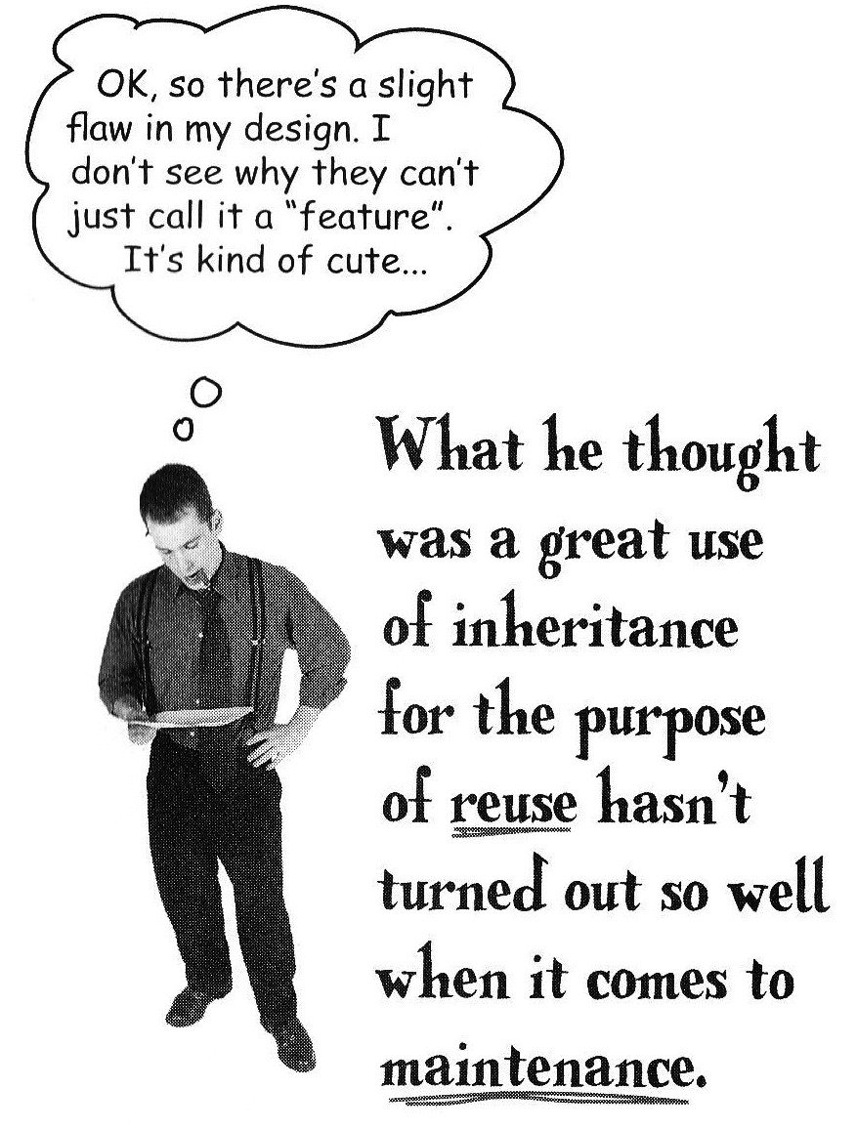
Something went wrong...

Slide 8
Alternatives
Duck
Display() //abstract
Quack(){//quack}
Fly(){//fly}
Override methods in subclasses
MallardDuck : Duck
RedheadDuck : Duck
Display() {//mallard duck}
Display() {//redhead duck}
RubberDuck : Duck
Display() {//rubber duck}
Quack(){//squeak}
Fly(){//do nothing}
DecoyDuck : Duck
Display() {//decoy duck}
Fly(){//do nothing}

Slide 9
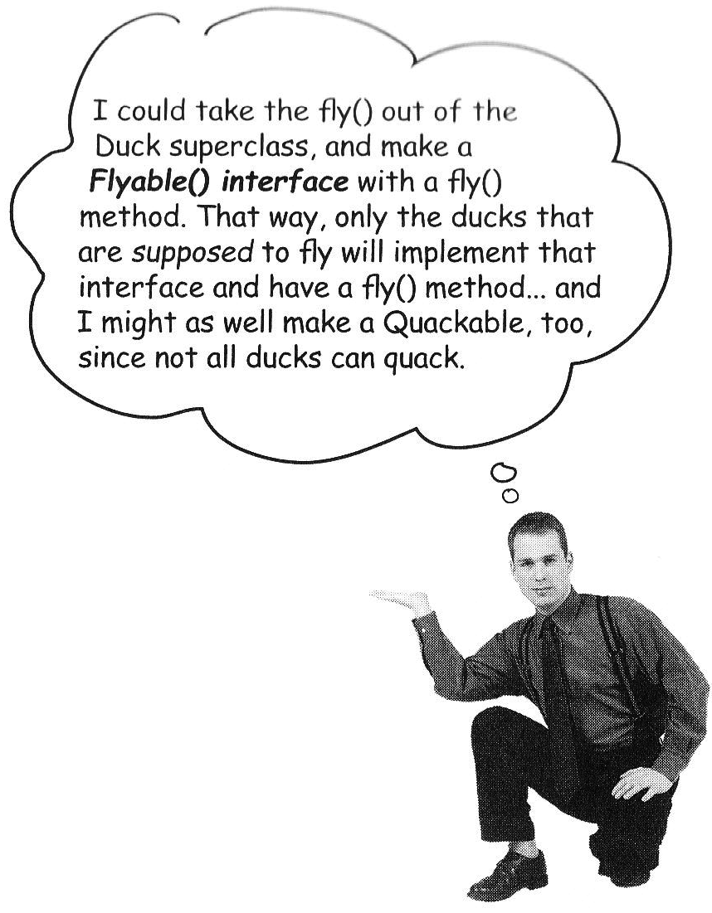
Alternatives
Create interfaces Flyable and Quackable

Slide 10

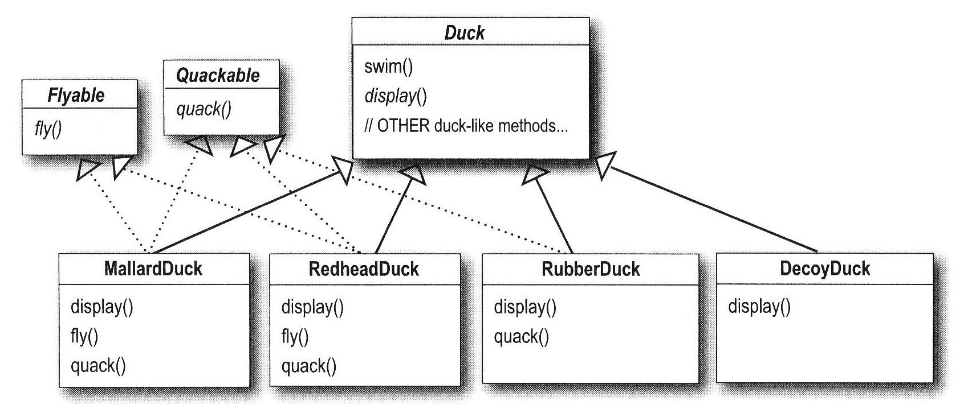
Alternatives
Create interfaces Flyable and Quackable

Slide 11
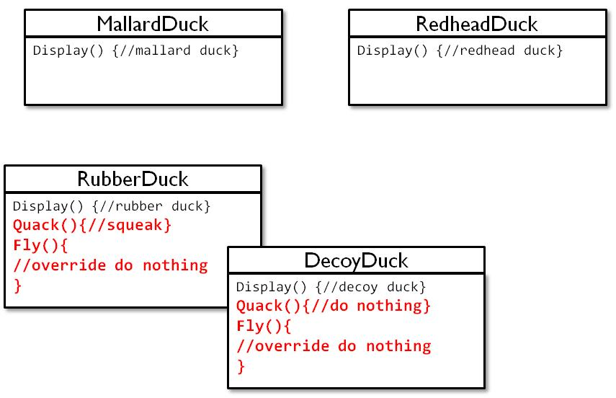

New requirement: 48 duck classes!
I want a solution without duplicate code

Slide 12
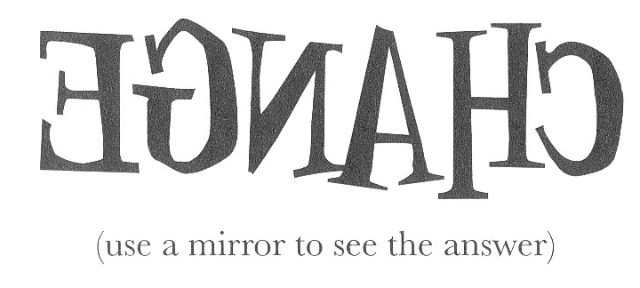
The one constant in software development

Slide 13
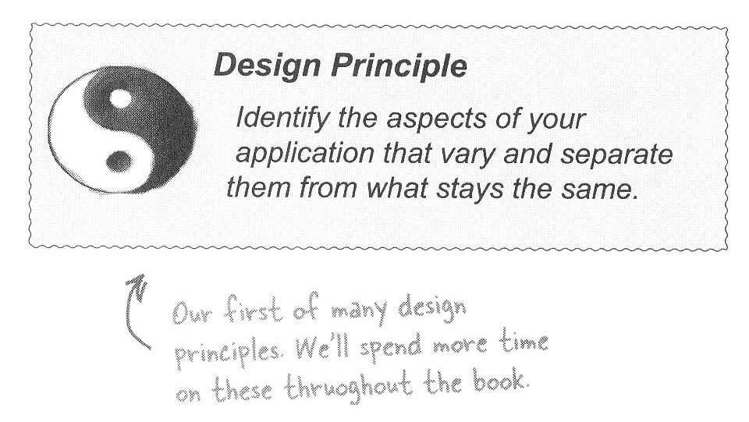
Design principle N° 1

Slide 14
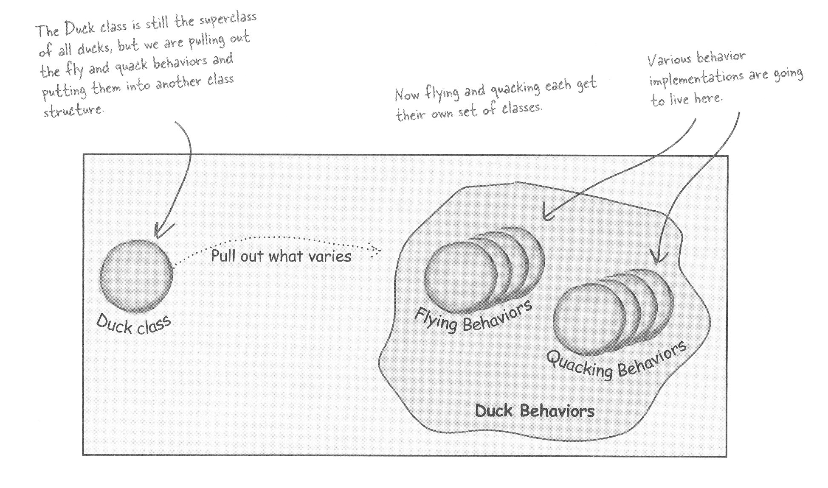
Separating what changes from what stays the same

Slide 15
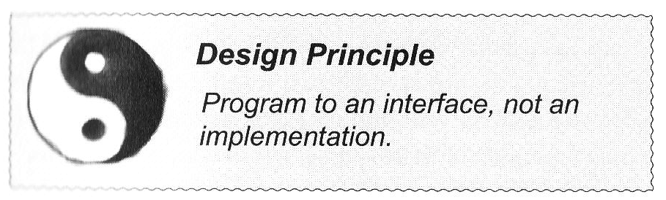
Design principle N° 2

Slide 16
Designing the Duck behaviors
<<interface>>
FlyBehavior
Fly()
FlyWithWings
FlyNoWay
Fly() {
//implements duck flying
}
Fly() {
//do nothing – can’t fly
}

Slide 17
Implementing the Duck behaviors
<<interface>>
FlyBehavior
Fly()
FlyWithWings
FlyNoWay
Fly() {
//implements duck flying
}
Fly() {
//do nothing – can’t fly
}
<<interface>>
QuackBehavior
Quack()
Quack
Squeak
MuteQuack
Quack() {
//implements duck quacking
}
Quack() {
//rubber duckie squeak
}
Quack() {
//do nothing – can’t quack
}

Slide 18
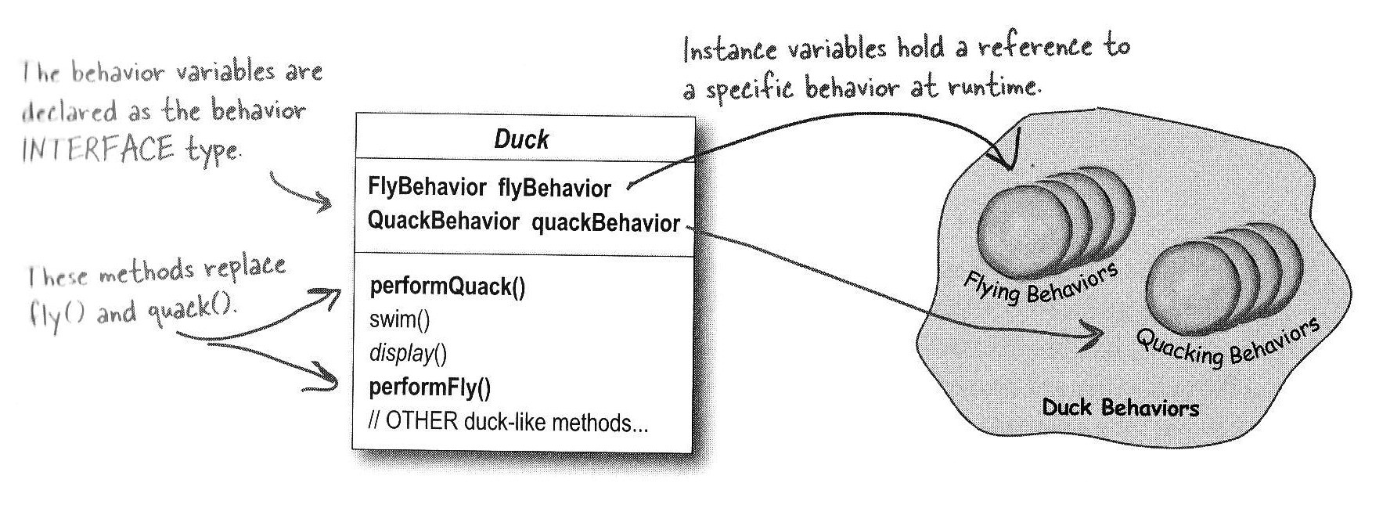
Integrating the Duck Behavior

Slide 19
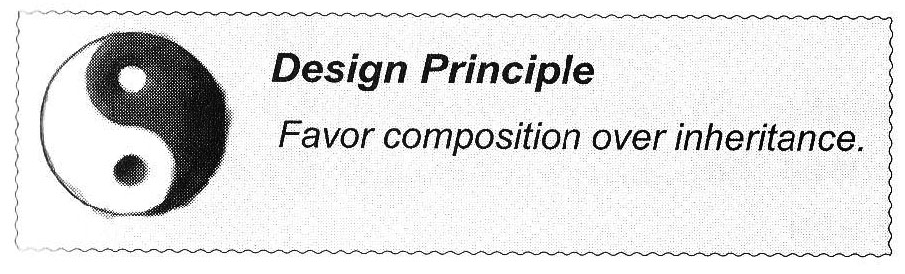
Design Principle N°3
HAS-A can be better than IS-A

Slide 20
Design Principles so far

Slide 21
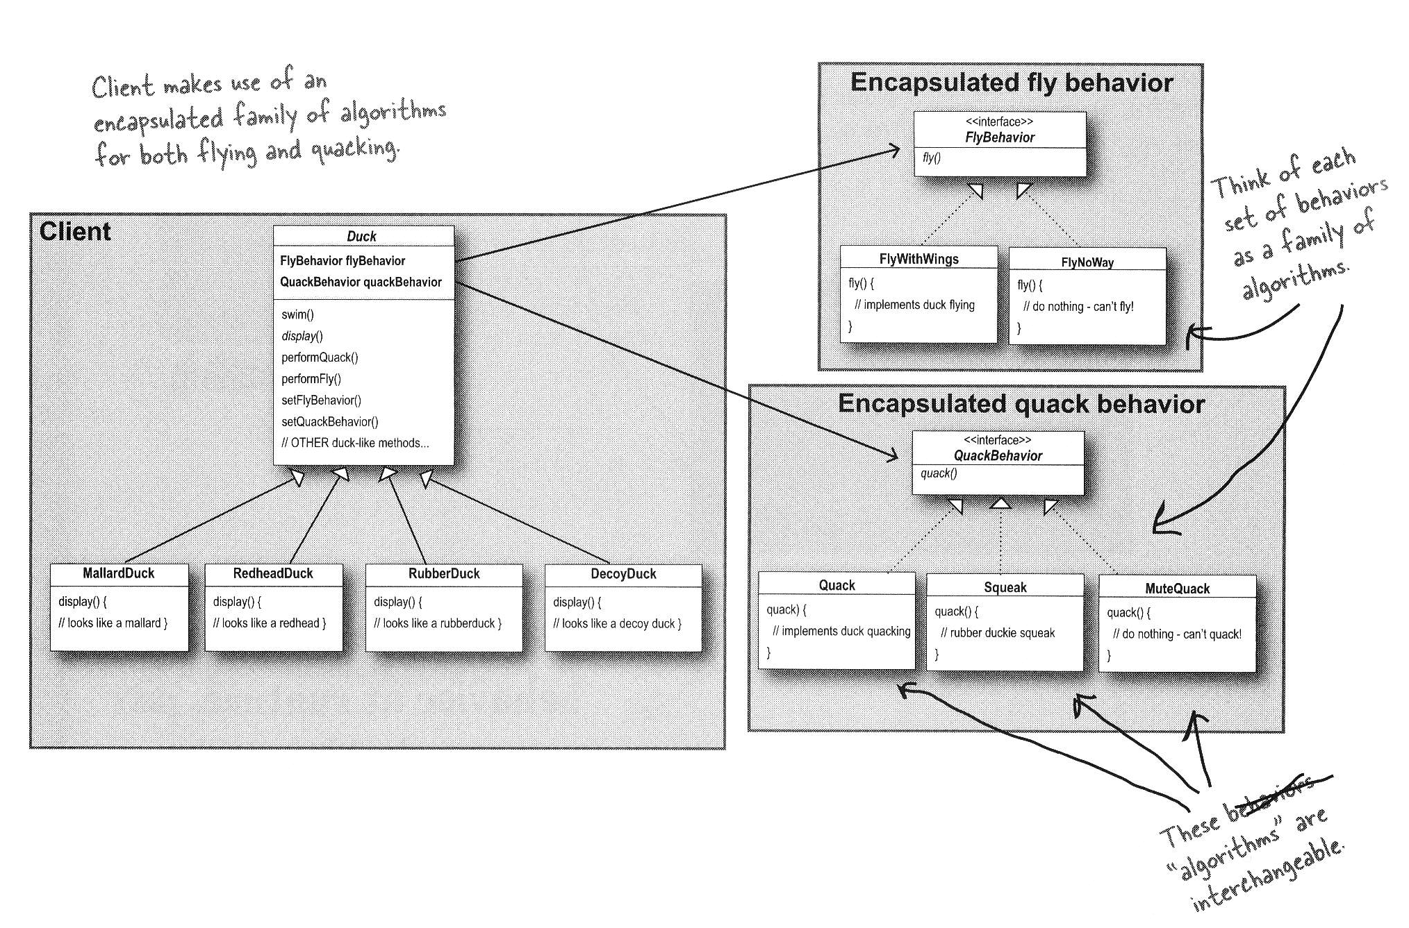
The big picture

